Slide 1

ImageMedix
By Team 5 The Minions
Sprint 1

Slide 2
Agenda
Team Roles & Responsibilities
Improvements from Professor Feedback
Project Description
Team Working Agreement
Personas
MVP
Technologies and Algorithms
Diagrams
Product Backlog
Sprint 1 Backlog
Metrics
Retrospective
Sprint 2 Plan
Sprint 1 Demo
GitHub Repository
Live Application Demo

Slide 3
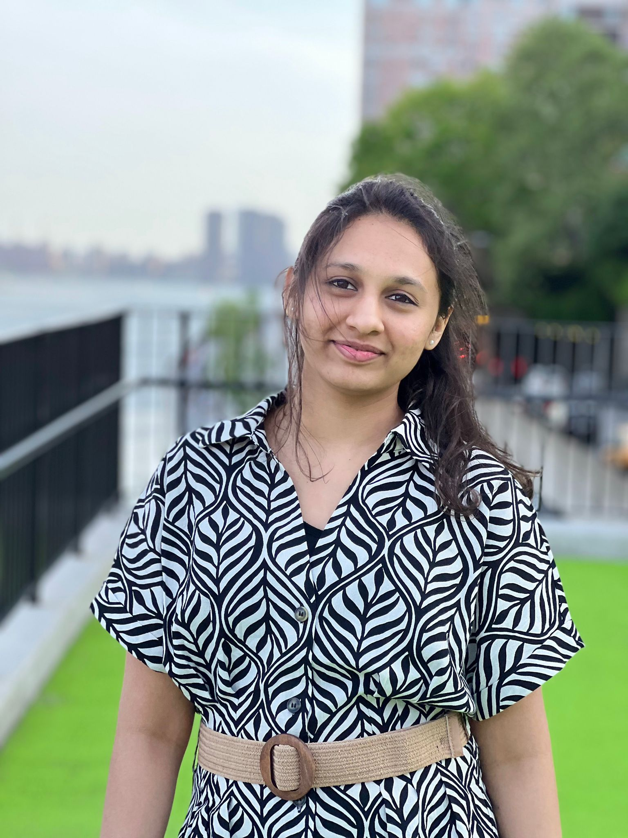
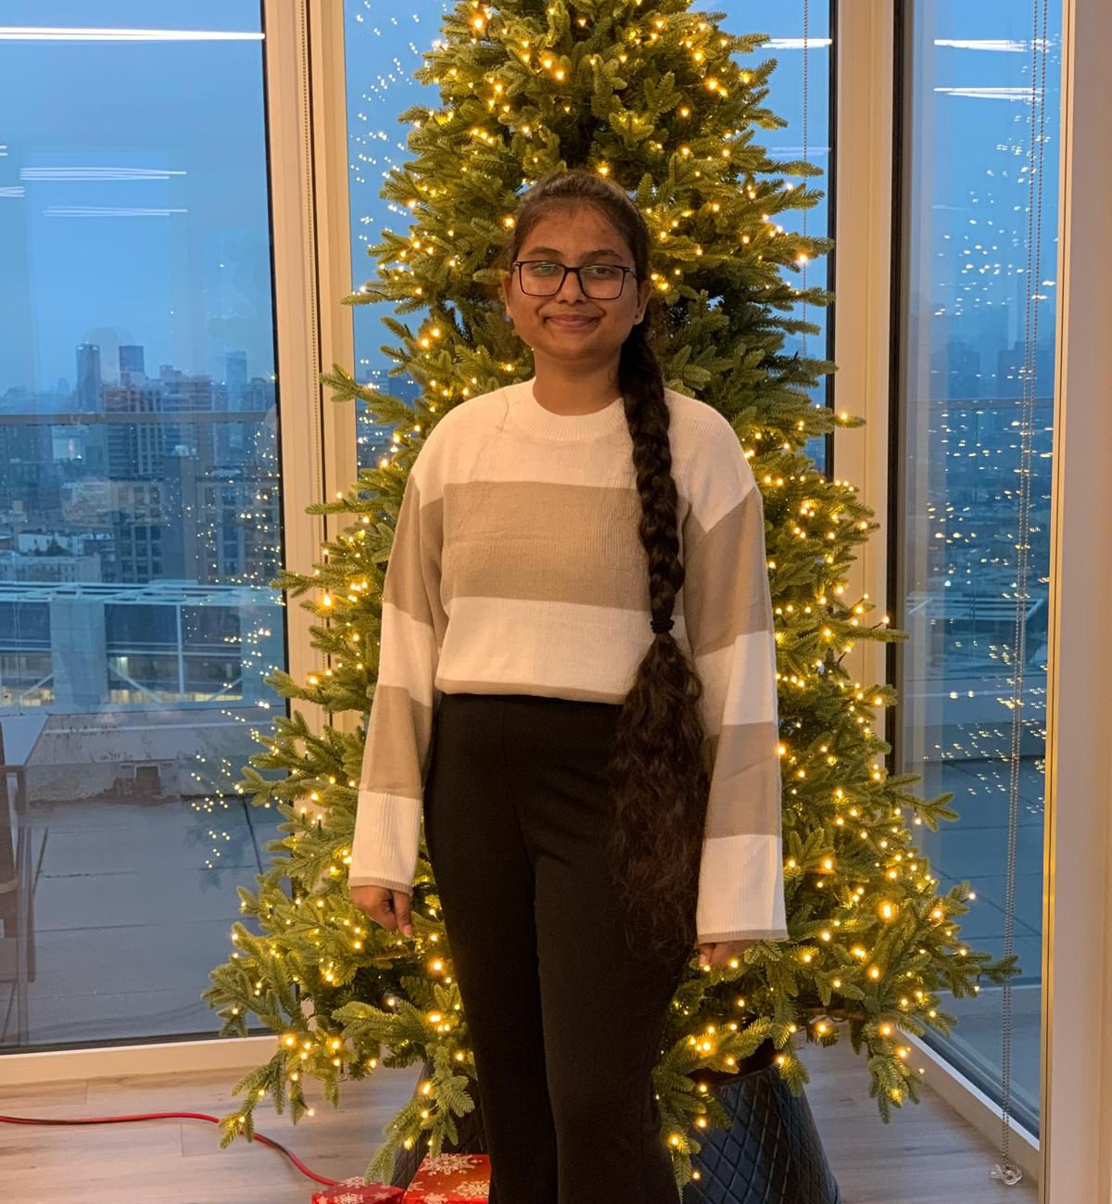
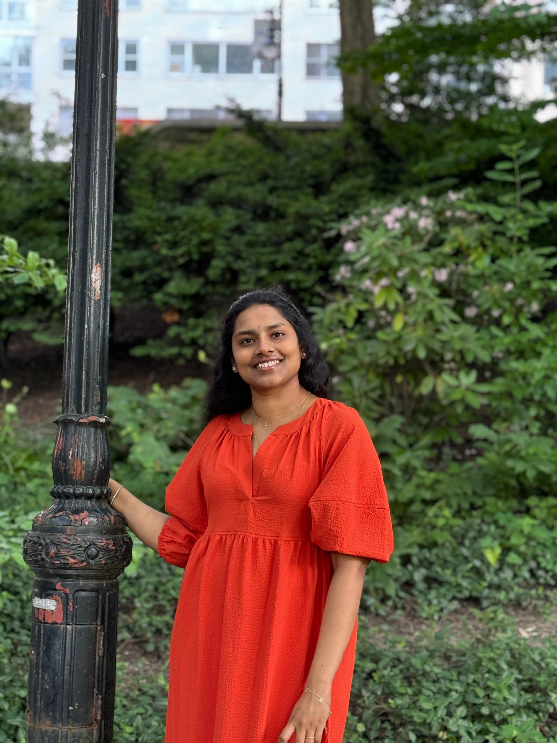
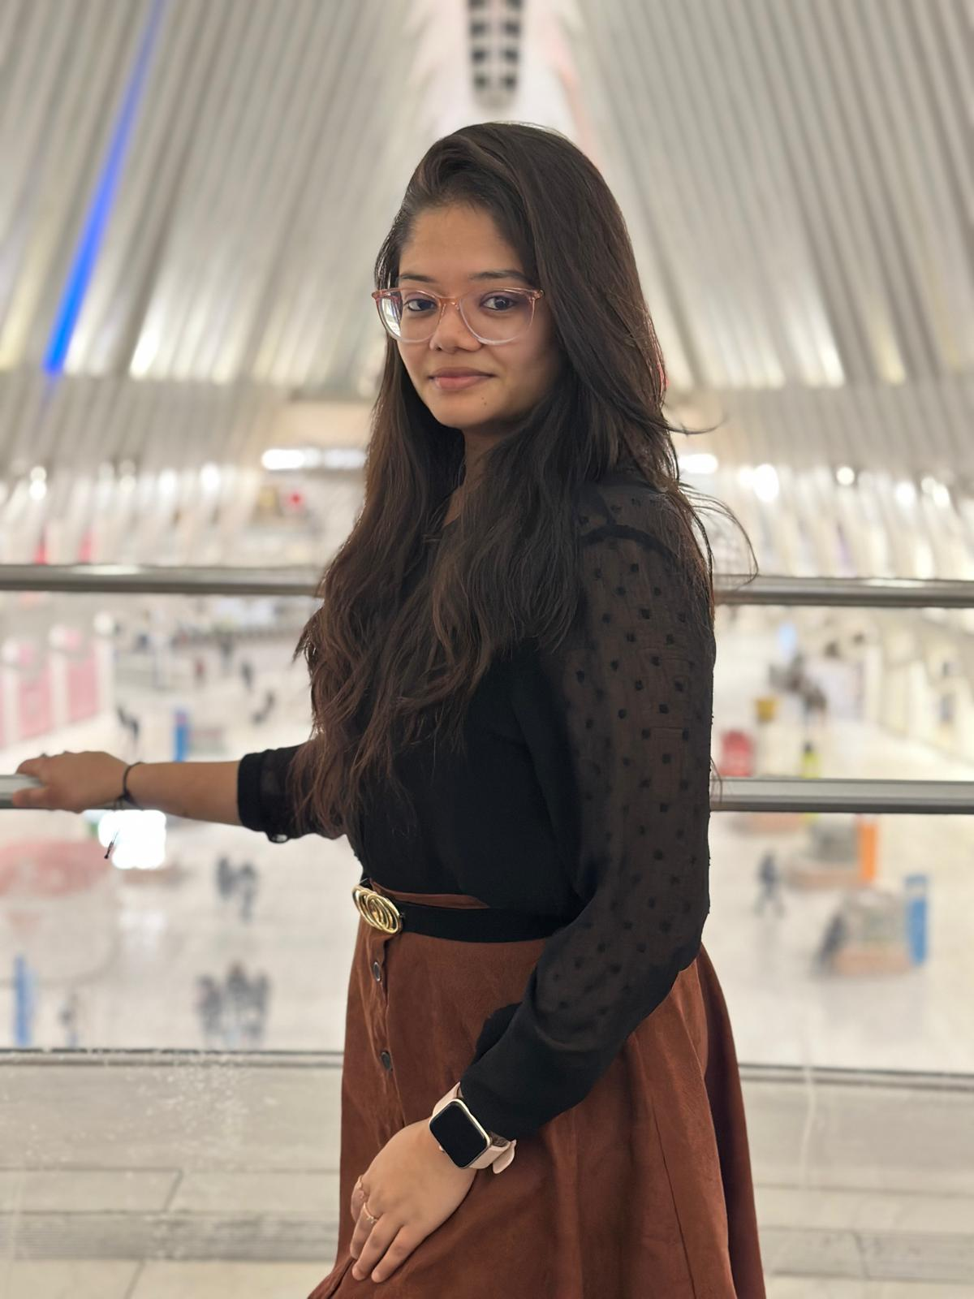
Team Members – machine learning
Vaishnavi Chandrasekar
Christiana Heden Kothuru
Deepika Mothkuri
Greeshma Kenche

Slide 4
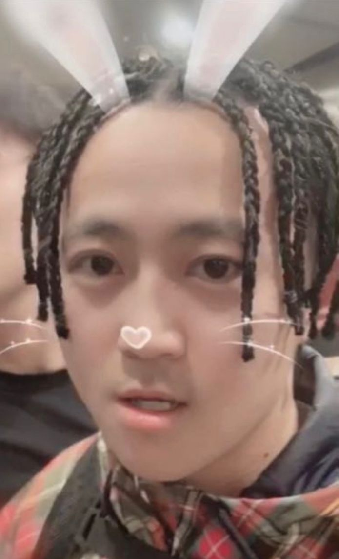
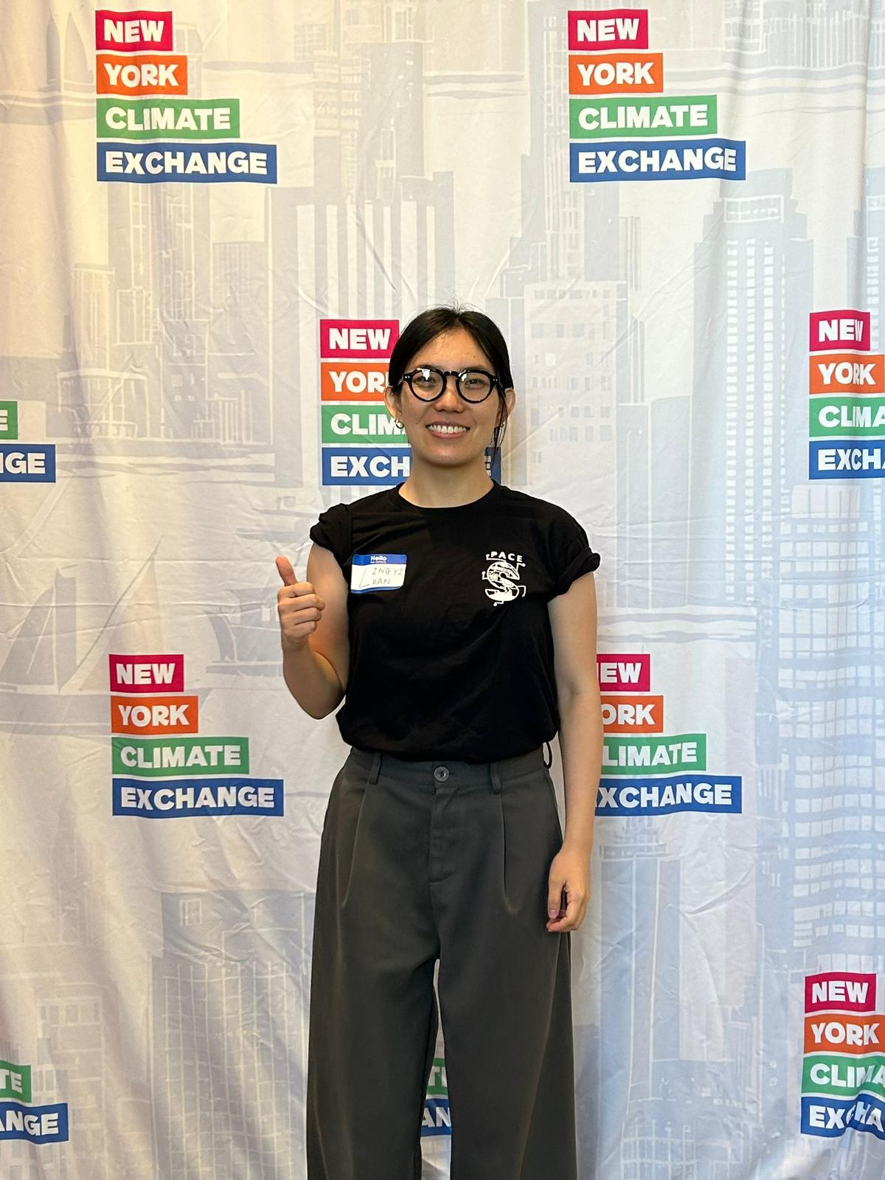
Team Members – Backend
Yucong Hu
Lingyi Luan

Slide 5
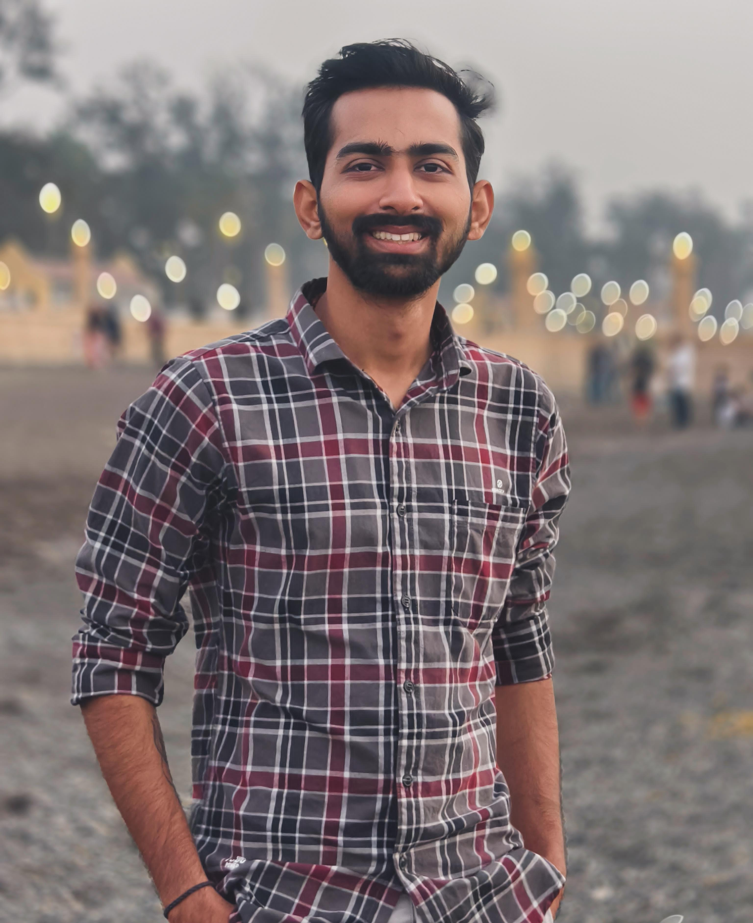
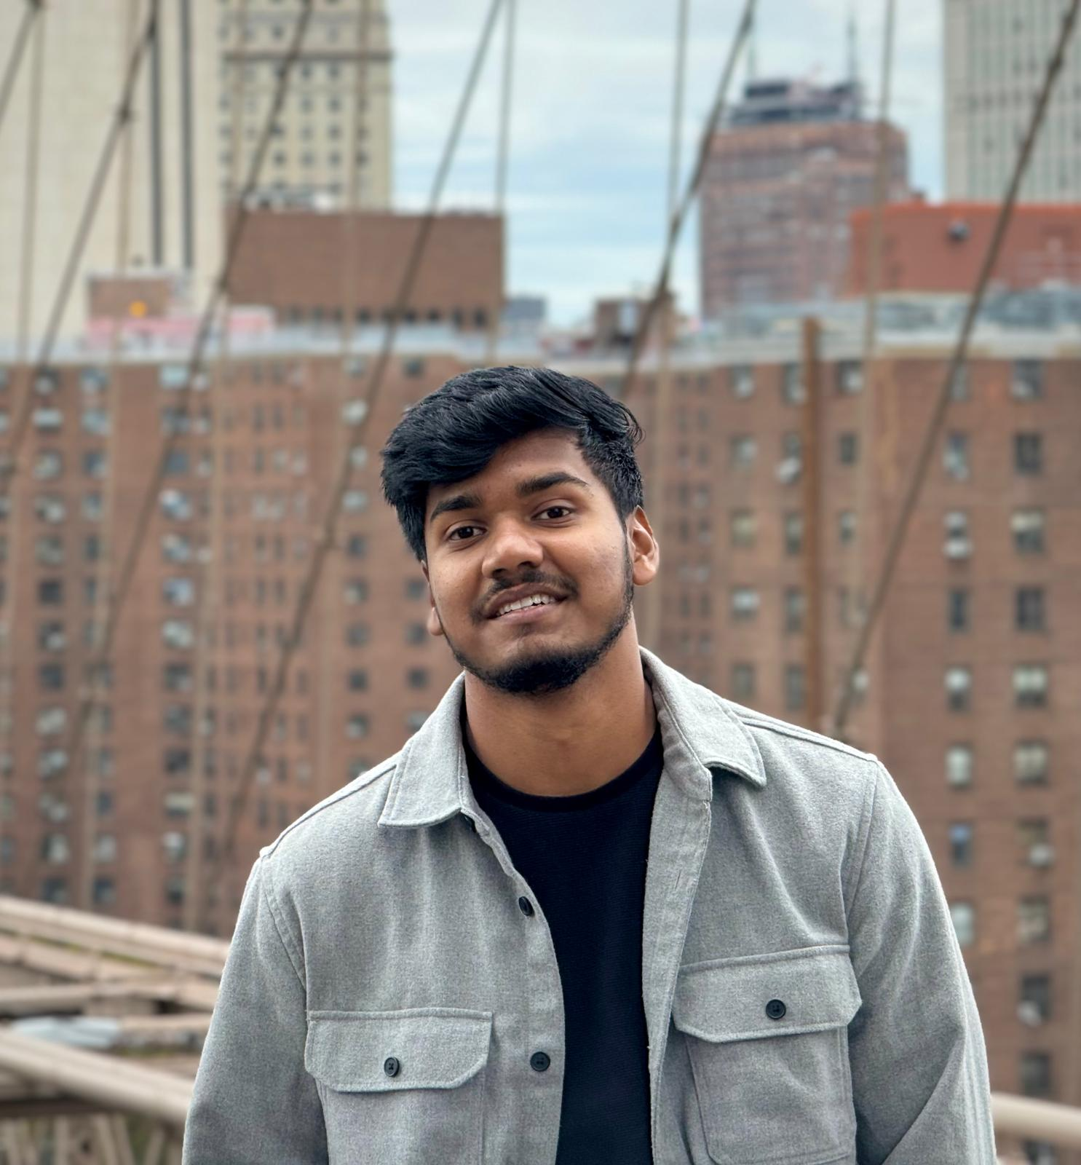
Team Members – Frontend
Yash Bhanubhai Panchani
Rameez Ahmed Shaik

Slide 6

Improvements
Improve team coordination

Slide 7
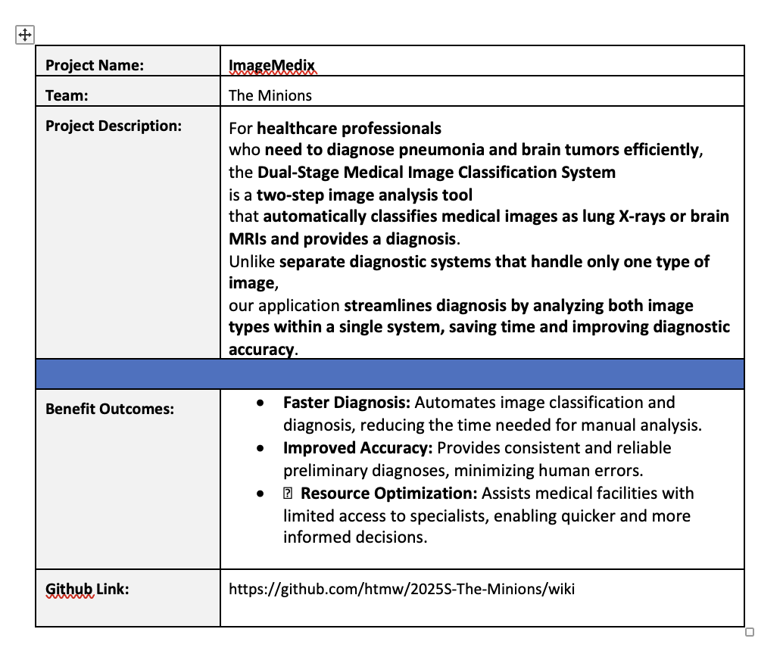
Project description

Slide 8
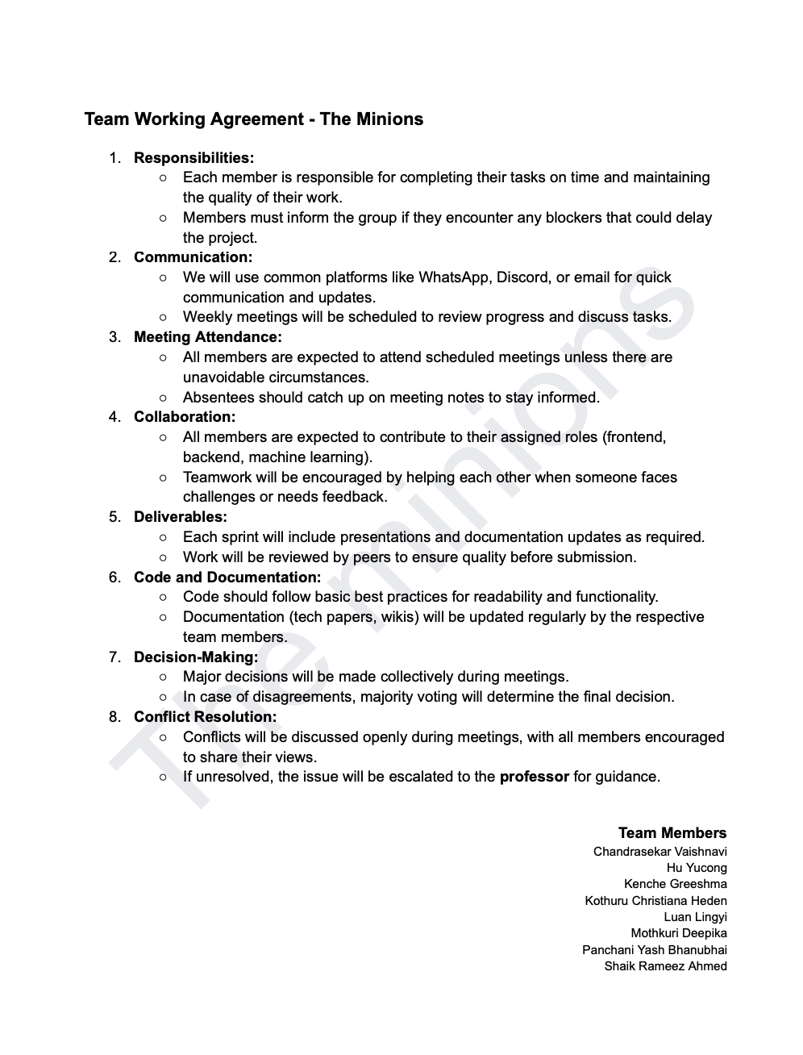
TEAM WORKING AGREEMENT

Slide 9
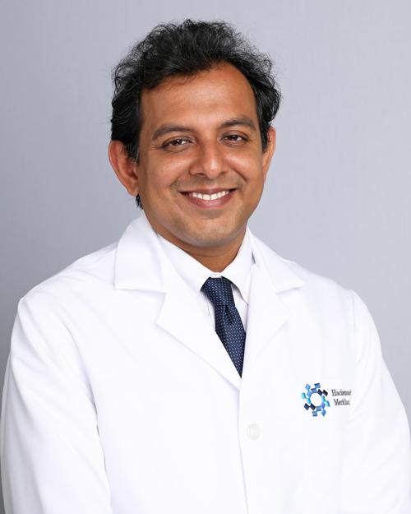
Personas
Dr. James Patel (Radiologist)
Age: 45
Occupation: Senior Radiologist at a metropolitan hospital
Background: Over 20 years of experience in diagnostic imaging, specializing in lung and brain disorders. Known for mentoring junior doctors in radiology.
Goals: To reduce the time spent analyzing large volumes of medical images while maintaining high diagnostic accuracy.
Challenges: Overloaded with image analysis requests and administrative duties, leading to delays in diagnosis and increased stress.
How the System Helps: Automates initial image classification and diagnosis, allowing Dr. Patel to prioritize critical and complex cases efficiently.

Slide 10
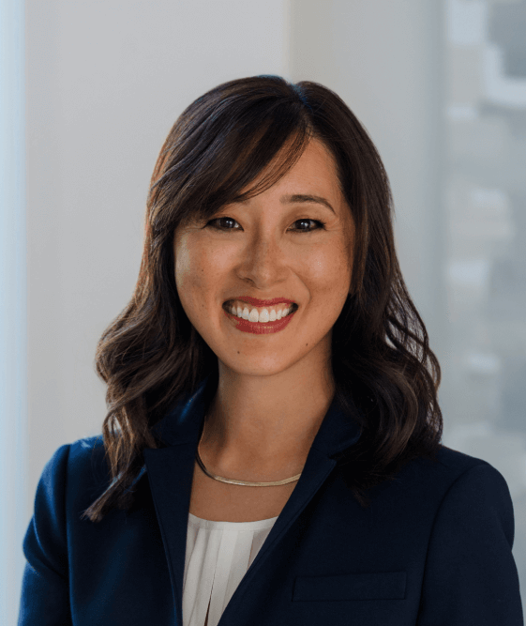
Personas
Dr. Suzen Chen (General Practitioner)
Age: 38
Occupation: General Practitioner at a rural healthcare clinic
Background: Has served in underserved regions for over a decade, often working without the immediate support of medical specialists. Committed to improving healthcare access in remote areas.
Goals: To provide fast, accurate diagnoses for patients despite limited access to specialists.
Challenges: She m ust handle a wide variety of cases on her own, making it difficult to diagnose complex conditions such as brain tumors and pneumonia accurately.
How the System Helps: The AI system offers reliable preliminary diagnoses for brain and lung conditions, helping Dr. Chen make timely and informed treatment decisions.

Slide 11
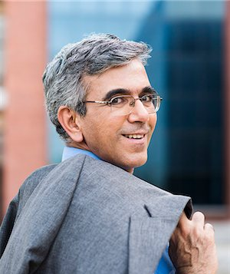
Personas
Dr. Raj Aryan (Healthcare Director)
Age: 50
Occupation: Director of a large hospital chain in India
Background: A visionary healthcare leader who has overseen the expansion of multiple hospitals across the country. Inspired by challenges faced in rural and semi-urban healthcare delivery.
Goals: To improve diagnostic efficiency, reduce patient wait times, and implement AI-based healthcare solutions across all branches.
Challenges: Delays in diagnosis caused by a shortage of skilled radiologists, leading to overcrowded hospitals and slow patient care.
How the System Helps: The automated system accelerates diagnosis processes across multiple hospitals, enabling faster and more efficient patient care, particularly in resource-constrained facilities.

Slide 12
MVP
Core Features
Two-Step Image Analysis
Classifies medical images as either lung X-rays or brain MRIs.
Provides automated diagnosis for pneumonia and brain tumors.
Automated Diagnosis System
Uses machine learning models to detect abnormalities.
Outputs a diagnostic result with confidence scores.
Unified Platform
Supports both lung X-rays and brain MRIs in a single system.
Eliminates the need for separate diagnostic tools.
User-Friendly Interface
Simple image upload functionality for healthcare professionals.
Displays classification results and diagnosis in an intuitive format.
Performance Metrics
Ensures accuracy through AI-driven predictions.
Optimized for faster diagnosis to reduce manual analysis time.
Basic Report Generation
Generates a preliminary diagnostic report.
Includes confidence levels and possible next steps for further medical review.

Slide 13






Technologies
Frontend: React.js
Used to create a user-friendly interface that allows healthcare professionals to upload and view medical images easily.
Backend: Node.js (API), Flask (Model Inference), MongoDB
Node.js: Handles API requests and manages communication between the frontend and backend services.
Flask: Supports model inference by running machine learning models for image classification and diagnosis.
MongoDB: Stores user data, images, and diagnostic results, enabling secure and scalable data management.
Machine Learning:
Built using PyTorch and trained on datasets for lung X-rays and brain MRIs.
Cloud Infrastructure:
Deployed using AWS.

Slide 14
Algorithms
The system uses two core algorithms based on pre-trained deep learning models. A ResNet model, fine-tuned on a dataset of medical images, is used to classify whether the uploaded image is a lung X-ray or a brain MRI. Depending on the classification result, the system proceeds to a second stage. For lung X-rays, a fine-tuned EfficientNet model detects and classifies pneumonia into normal, viral, or bacterial categories by analyzing lung patterns. For brain MRIs, the same EfficientNet model is used to detect and classify brain tumors into glioma, meningioma, or no tumor by identifying abnormalities in brain structures. These models provide high accuracy and efficiency, ensuring reliable diagnoses for both image types.

Slide 15
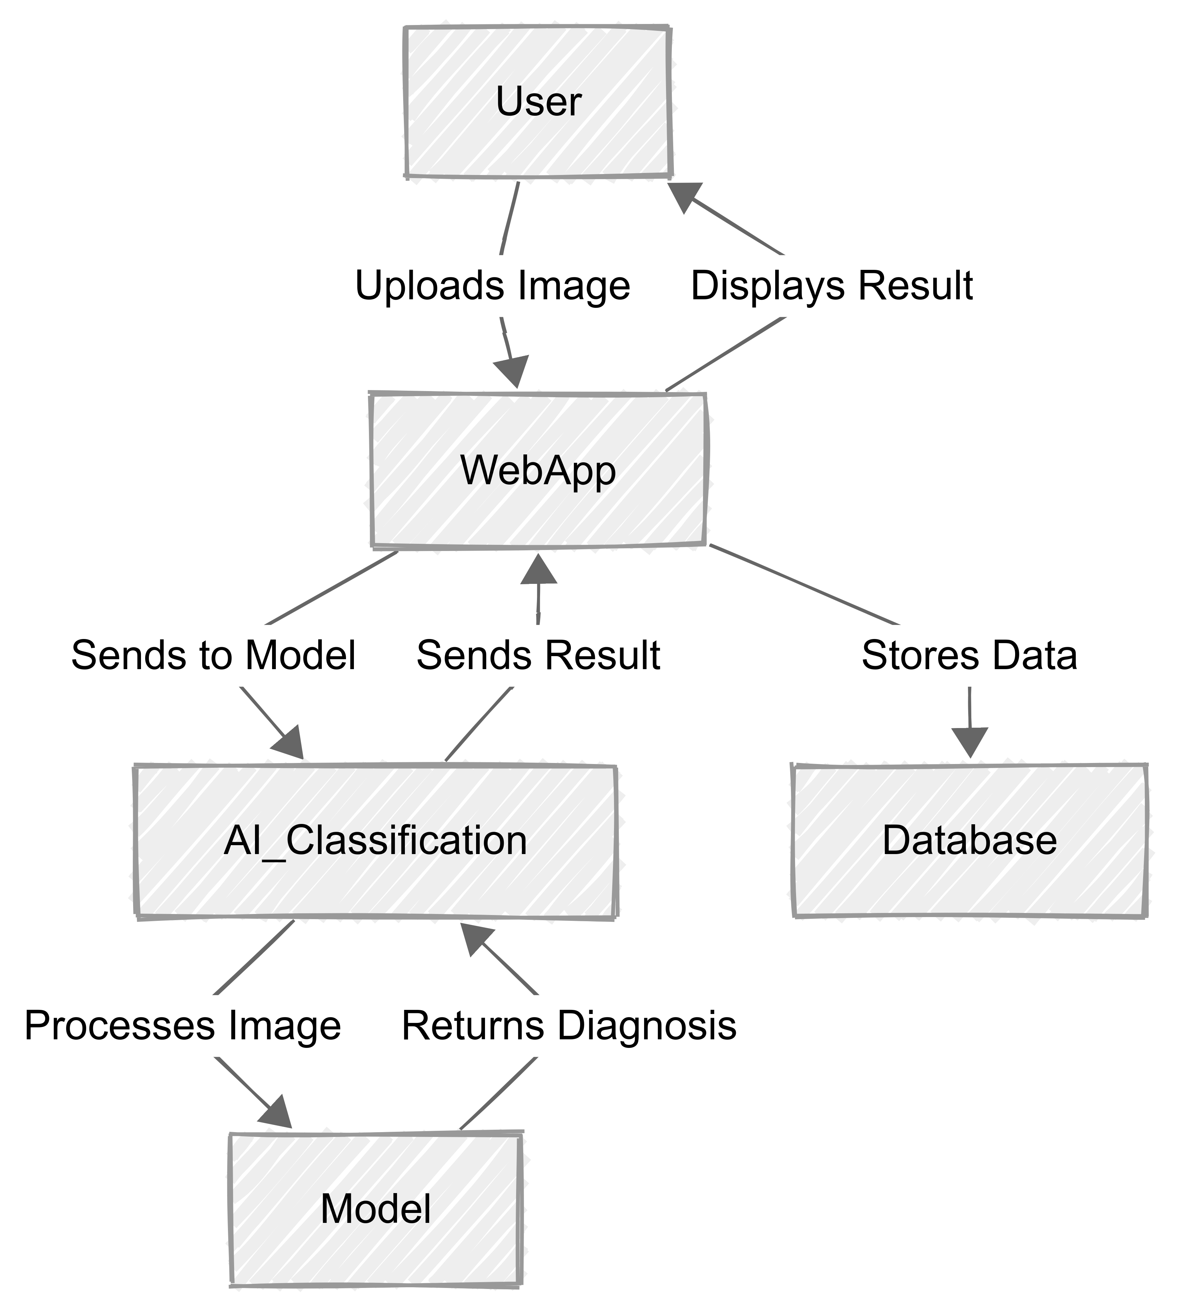
Architecture Diagram

Slide 16
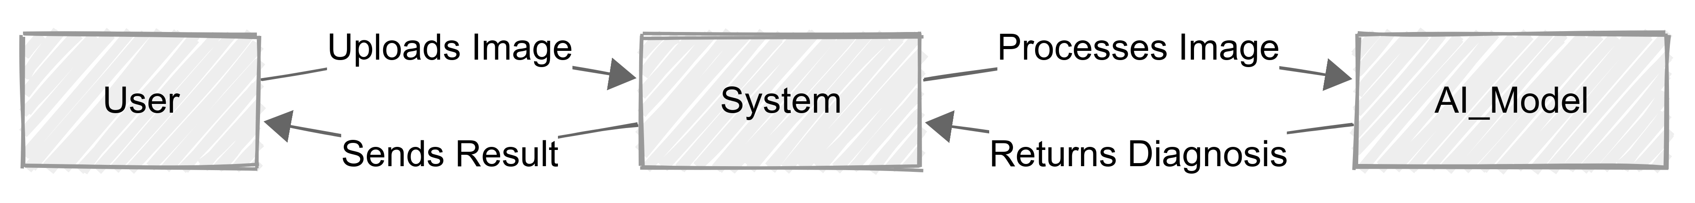
Context diagram

Slide 17
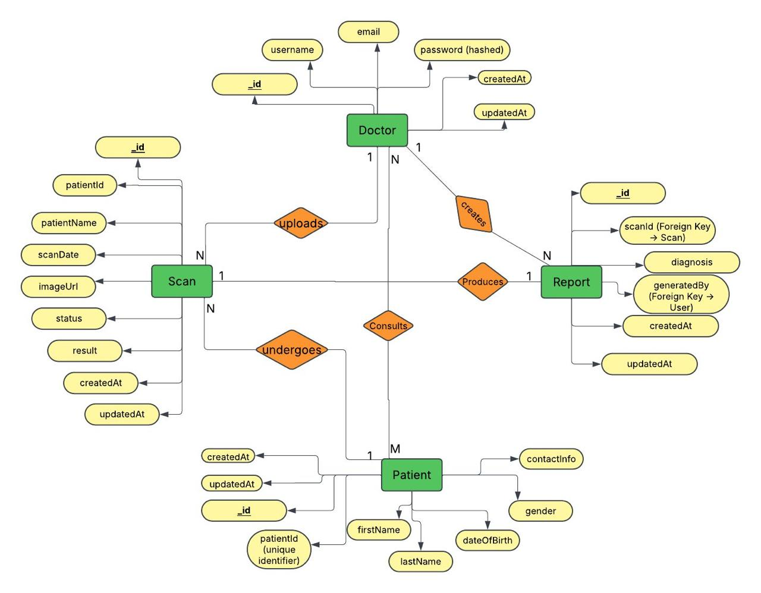
ER Diagram

Slide 18
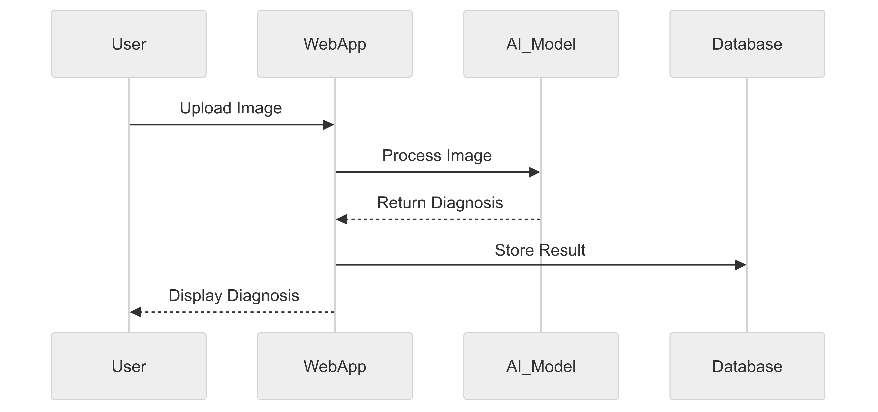
SEQUENCE DIAGRAM

Slide 19
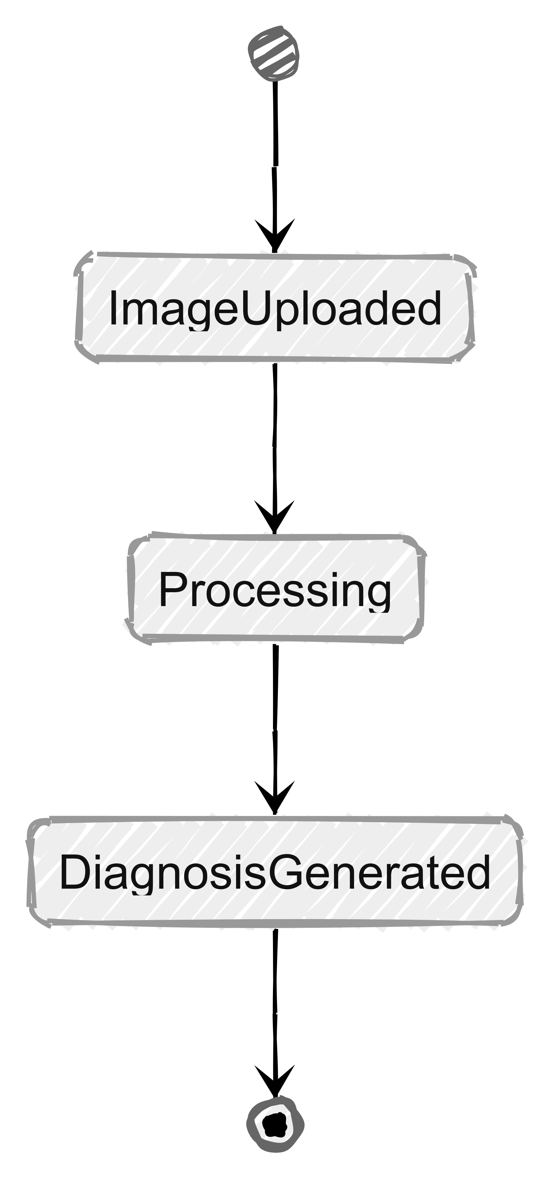
State diagram

Slide 20
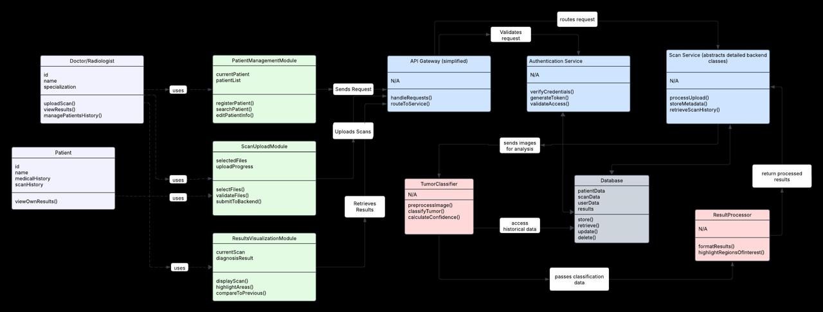
CLASS DIAGRAM

Slide 21
Product Backlog
ID | Sprint | User Story / Technical Story (TS) | Acceptance Criteria | Story Points (SP)
US-01 | Sprint 1 | As a user, I want a visually appealing landing page so I can understand the system at a glance. | Must include a header, project description, CTA button, and demo preview. | 3
US-02 | Sprint 1 | As a user, I want an intuitive navigation menu so I can easily access different sections of the website. | Implement navbar with links to Home, Upload, Results, and About. | 2
US-03 | Sprint 1 | As a user, I want a simple image upload interface so I can easily upload my medical images. | Create a file upload UI (Frontend only, no backend integration). | 3
US-04 | Sprint 1 | As a user, I want a responsive design so I can access the site on mobile devices. | Ensure UI adapts well to different screen sizes. | 2

Slide 22
ID | Sprint | User Story / Technical Story (TS) | Acceptance Criteria | Story Points (SP)
US-05 | Sprint 1 | As a user, I want to see a static results page so I understand how the diagnosis will be displayed. | Create a placeholder UI for displaying diagnostic results. | 2
TS-01 | Sprint 1 | Set up frontend framework and project structure. As a developer, I want to set up the frontend framework and project structure so that the development process is organized and scalable. | Initialize React project and configure routing. | 2
TS-02 | Sprint 1 | Implement UI components for buttons, inputs, and cards. | Ensure reusable and styled components are available. | 3
US-06 | Sprint 2 | As a developer, I want to implement UI components for buttons, inputs, and cards so that the system has reusable and consistent elements. | Enable image uploads and store images in the database. | 5

Slide 23
ID | Sprint | User Story / Technical Story (TS) | Acceptance Criteria | Story Points (SP)
US-07 | Sprint 2 | As a user, I want my medical image to be analyzed automatically so I can receive a diagnosis. | Integrate AI model for classification of lung X-rays and brain MRIs. | 8
US-08 | Sprint 2 | As a user, I want to see my diagnosis displayed clearly so I can understand the results. | Display AI-generated results on the frontend. | 3
US-09 | Sprint 2 | As a user, I want my diagnosis results to be stored so I can access them later. | Store diagnosis and image data in a database. | 5
US-10 | Sprint 2 | As a user, I want basic account authentication so I can securely log in and access my past diagnoses. | Implement login/sign-up functionality. | 5

Slide 24
ID | Sprint | User Story / Technical Story (TS) | Acceptance Criteria | Story Points (SP)
TS-03 | Sprint 2 | As a developer, I want to set up a backend API for image processing so that the system can analyze uploaded images efficiently. | Develop Flask/Django API to handle image uploads and analysis. | 8
TS-04 | Sprint 2 | As a developer, I want to connect the frontend with the backend API so that data flows seamlessly between the client and server. | Ensure API endpoints are properly integrated with React. | 5
US-11 | Sprint 3 | As a user, I want my diagnosis report to be downloadable so I can share it with doctors. | Generate PDF reports for diagnosis results. | 5
US-12 | Sprint 3 | As a user, I want a faster processing time so I don’t have to wait long for results. | Optimize AI model inference time to under 2 seconds. | 8

Slide 25
ID | Sprint | User Story / Technical Story (TS) | Acceptance Criteria | Story Points (SP)
US-13 | Sprint 3 | As a user, I want role-based access (doctor, patient, admin) so I can have personalized features. | Implement RBAC with different user permissions. | 5
US-14 | Sprint 3 | As a user, I want the system to be highly accurate so I can trust the diagnosis. | Improve AI model accuracy to at least 90%. | 8
US-15 | Sprint 3 | As a user, I want to access the system online so I can use it from anywhere. | Deploy the web application and make it publicly accessible. | 5
TS-05 | Sprint 3 | As a developer, I want to implement logging and error handling so that system failures can be monitored and resolved efficiently. | Ensure system logs errors and alerts admin for failures. | 3

Slide 26
Sprint 1 backlog
ID | User Story / Task (TS) | Acceptance Criteria (AC) | Story Points (SP)
US-01 | As a user, I want a visually appealing landing page so I can understand the system at a glance. | Must include a header, project description, CTA button, and demo preview. | 3
US-02 | As a user, I want an intuitive navigation menu so I can easily access different sections of the website. | Implement navbar with links to Home, Upload, Results, and About. | 2
US-03 | As a user, I want a simple image upload interface so I can easily upload my medical images. | Create a file upload UI (Frontend only, no backend integration). | 3
US-04 | As a user, I want a responsive design so I can access the site on mobile devices. | Ensure UI adapts well to different screen sizes. | 2
US-05 | As a user, I want to see a static results page so I understand how the diagnosis will be displayed. | Create a placeholder UI for displaying diagnostic results. | 2
TS-01 | Set up frontend framework and project structure. As a developer, I want to set up the frontend framework and project structure so that the development process is organized and scalable. | Initialize React project and configure routing. | 2
TS-02 | Implement UI components for buttons, inputs, and cards. | Ensure reusable and styled components are available. | 3

Slide 27
Sprint 1 test cases
ID | Test Case | Expected Result | Actual Result | Pass/Fail
US-01-TC01 | Load the landing page. | The page should display project description, CTA button, and a demo preview. | The landing page loads with all required elements correctly displayed. | Pass
US-02-TC01 | Click on each navbar link (Home, Upload, Results, About). | The user should be navigated to the correct section/page. | Navbar links navigate to the correct pages smoothly. | Pass
US-03-TC01 | Try uploading an image (PNG, JPG). | The file should be accepted and UI should show a preview. | Image upload works, but preview does not appear. | Fail
US-03-TC02 | Try uploading a non-image file (PDF, TXT). | The UI should display an error message. | The UI correctly blocks non-image files and shows an error message. | Pass
US-04-TC01 | Resize the browser window to mobile size. | The UI layout should adjust properly. | The layout adapts correctly to different screen sizes. | Pass
US-05-TC01 | Open the static results page. | The placeholder UI should be visible. | Placeholder UI is visible, but the styling needs adjustments. | Fail
TS-01-TC01 | Check if the React project runs successfully. | The application should compile and load without errors. | The React project runs successfully with no build errors. | Pass
TS-02-TC01 | Verify button and input components. | UI components should render correctly with proper styles. | Buttons and inputs display correctly and are functional. | Pass

Slide 28
Sprint 1 Stories completed
ID | User Story / Task (TS) | Acceptance Criteria (AC) | Story Points (SP)
US-01 | As a user, I want a visually appealing landing page so I can understand the system at a glance. | Must include a header, project description, CTA button, and demo preview. | 3
US-02 | As a user, I want an intuitive navigation menu so I can easily access different sections of the website. | Implement navbar with links to Home, Upload, Results, and About. | 2
US-04 | As a user, I want a responsive design so I can access the site on mobile devices. | Ensure UI adapts well to different screen sizes. | 2
TS-01 | Set up frontend framework and project structure. As a developer, I want to set up the frontend framework and project structure so that the development process is organized and scalable. | Initialize React project and configure routing. | 2
TS-02 | Implement UI components for buttons, inputs, and cards. | Ensure reusable and styled components are available. | 3

Slide 29
Sprint 1 Stories Not completed
ID | User Story / Task (TS) | Acceptance Criteria (AC) | Story Points (SP) | Reason for Incompletion
US-03 | As a user, I want a simple image upload interface so I can easily upload my medical images. | Create a file upload UI (Frontend only, no backend integration). | 3 | Image upload preview not displaying properly.
US-05 | As a user, I want to see a static results page so I understand how the diagnosis will be displayed. | Create a placeholder UI for displaying diagnostic results. | 2 | UI styling needs adjustments to match design.

Slide 30
Metrics
Team Velocity
Total Story Points Completed: 12 SP
Team Velocity: 12 SP
Completed/Committed Ratio
Total Story Points Committed: 17 SP
Total Story Points Completed: 12 SP
Completed/Committed Ratio: (12/17) = 70.59%

Slide 31
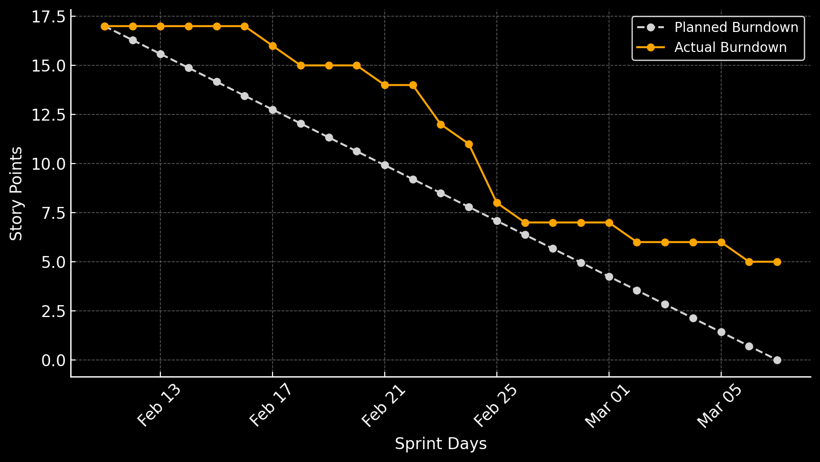
BURNDOWN CHART

Slide 32
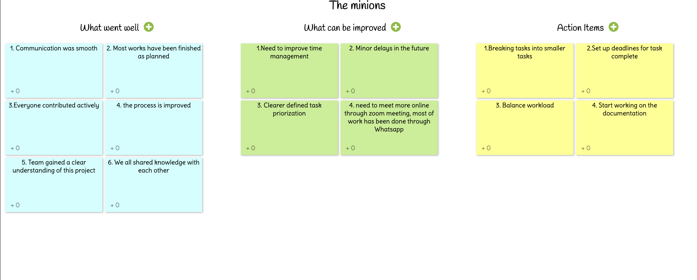
rETROSPECTIVE

Slide 33
Sprint 2 planning
ID | User Story / Task (TS) | Acceptance Criteria (AC) | Story Points (SP)
US-06 | As a user, I want to upload an image and get it processed so I can receive a diagnosis. | Enable image uploads and store images in the database. | 5
US-07 | As a user, I want my medical image to be analyzed automatically so I can receive a diagnosis. | Integrate AI model for classification of lung X-rays and brain MRIs. | 8
US-08 | As a user, I want to see my diagnosis displayed clearly so I can understand the results. | Display AI-generated results on the frontend. | 3
US-09 | As a user, I want my diagnosis results to be stored so I can access them later. | Store diagnosis and image data in a database. | 5
US-10 | As a user, I want basic account authentication so I can securely log in and access my past diagnoses. | Implement login/sign-up functionality. | 5

Slide 34
Sprint 2 planning
ID | User Story / Task (TS) | Acceptance Criteria (AC) | Story Points (SP)
US-03 | (Carried from Sprint 1) As a user, I want a simple image upload interface so I can easily upload my medical images. | Fix image preview issue. | 3
US-05 | (Carried from Sprint 1) As a user, I want to see a static results page so I understand how the diagnosis will be displayed. | Fix UI styling issues. | 2
TS-03 | As a developer, I want to set up a backend API for image processing so that the system can analyze uploaded images efficiently. | Develop Flask/Django API to handle image uploads and analysis. | 8
TS-04 | As a developer, I want to connect the frontend with the backend API so that data flows seamlessly between the client and server. | Ensure API endpoints are properly integrated with React. | 5

Slide 35
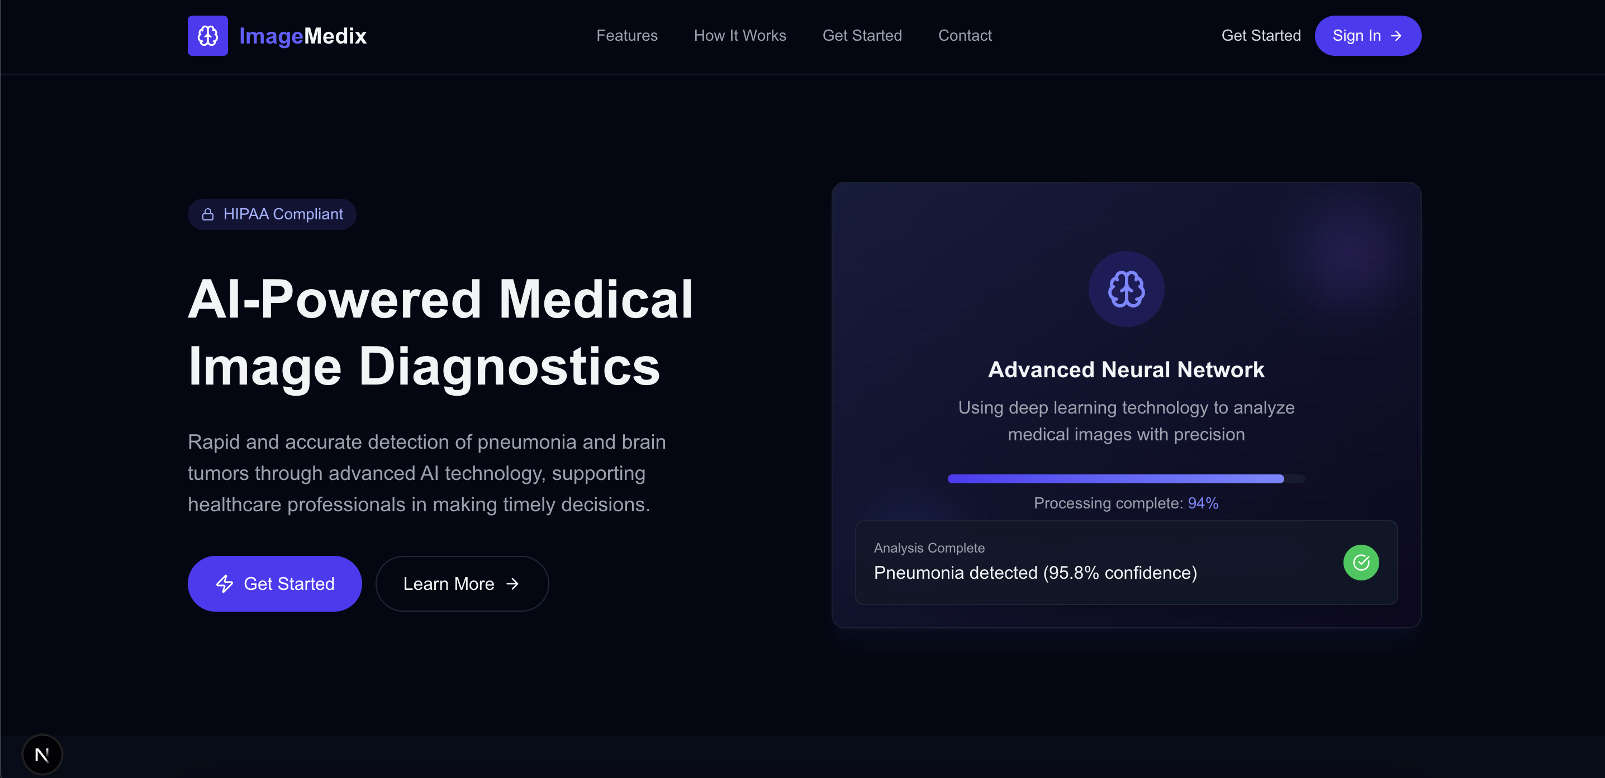
Application SCreenshots

Slide 36
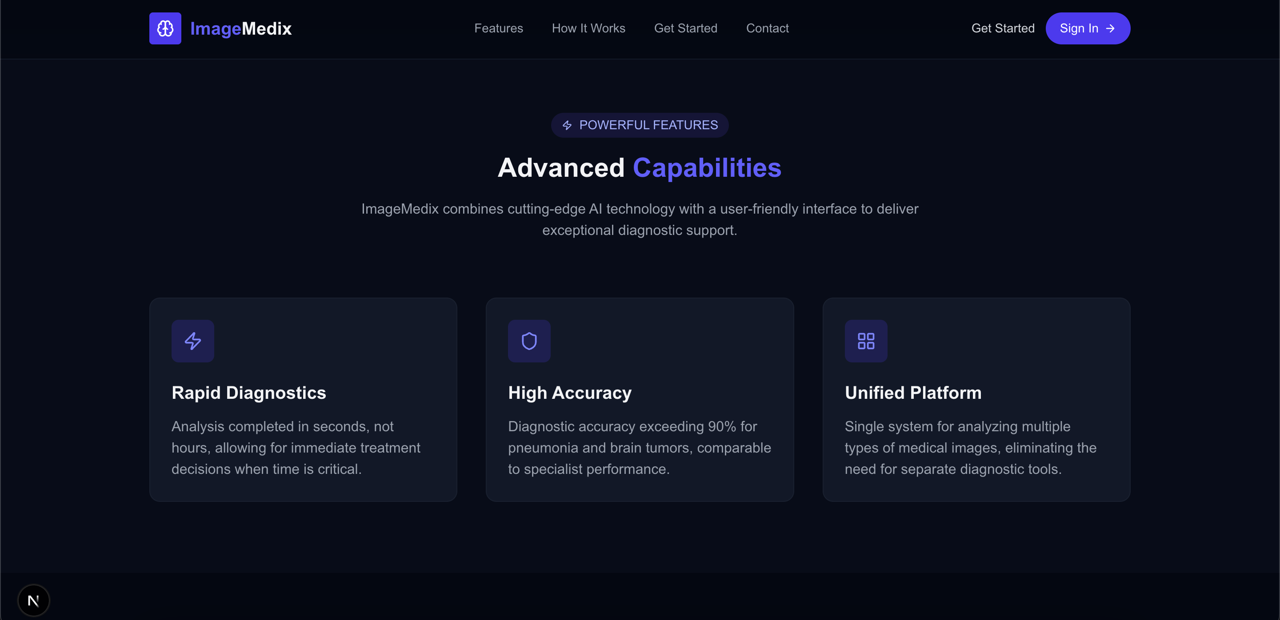

Slide 37
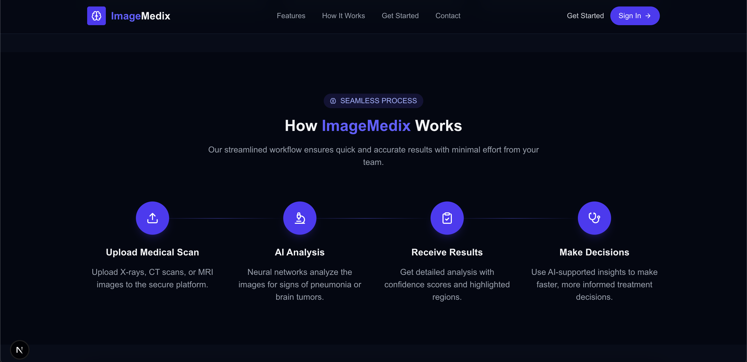

Slide 38
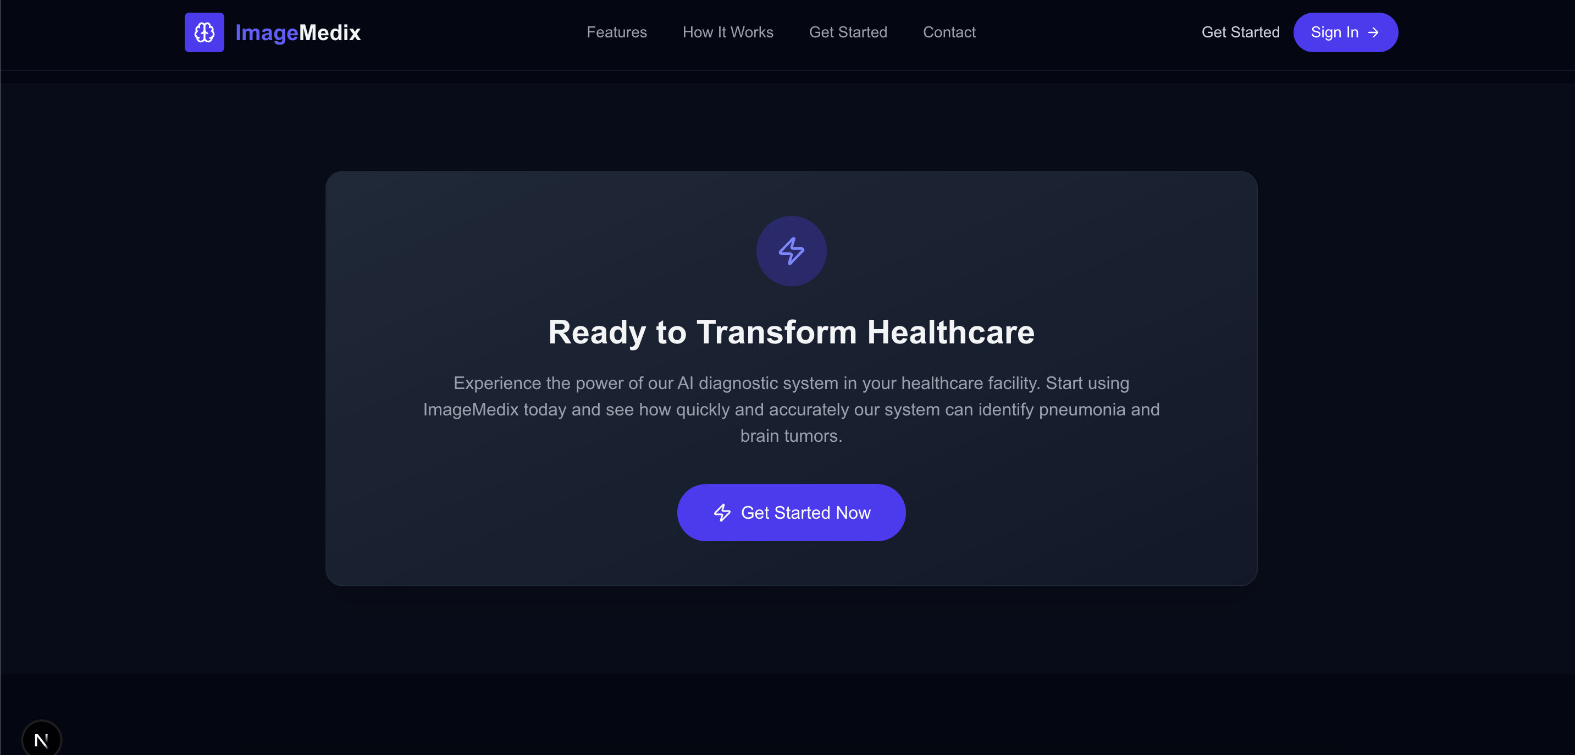

Slide 39
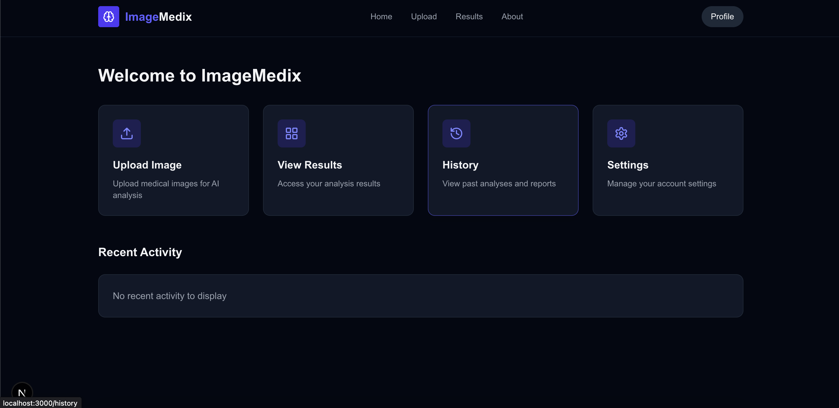

Slide 41
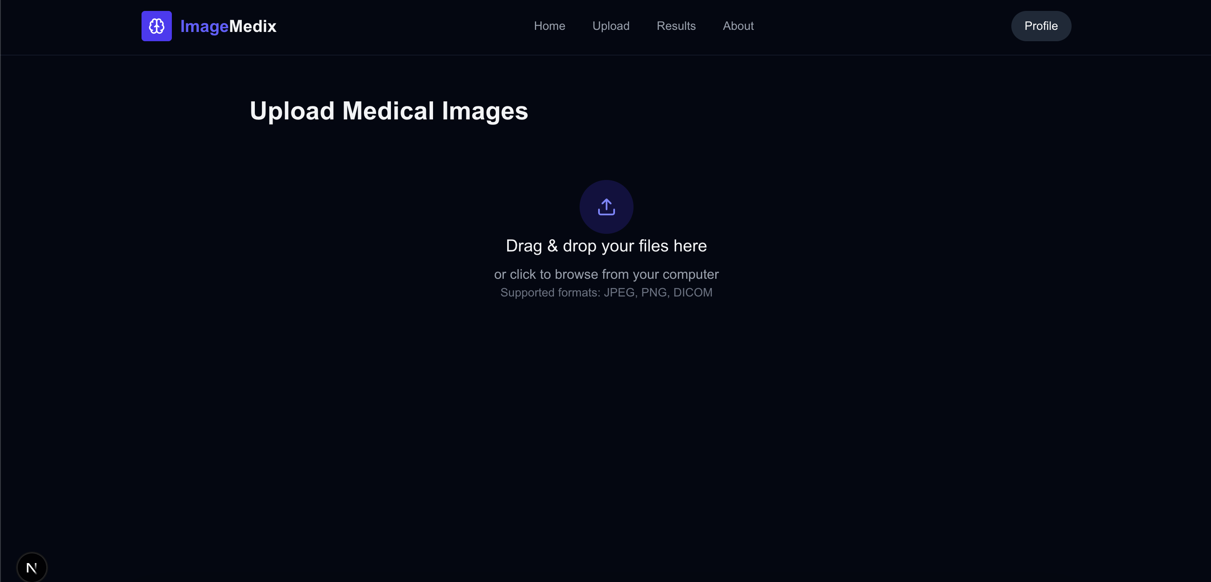

Slide 42
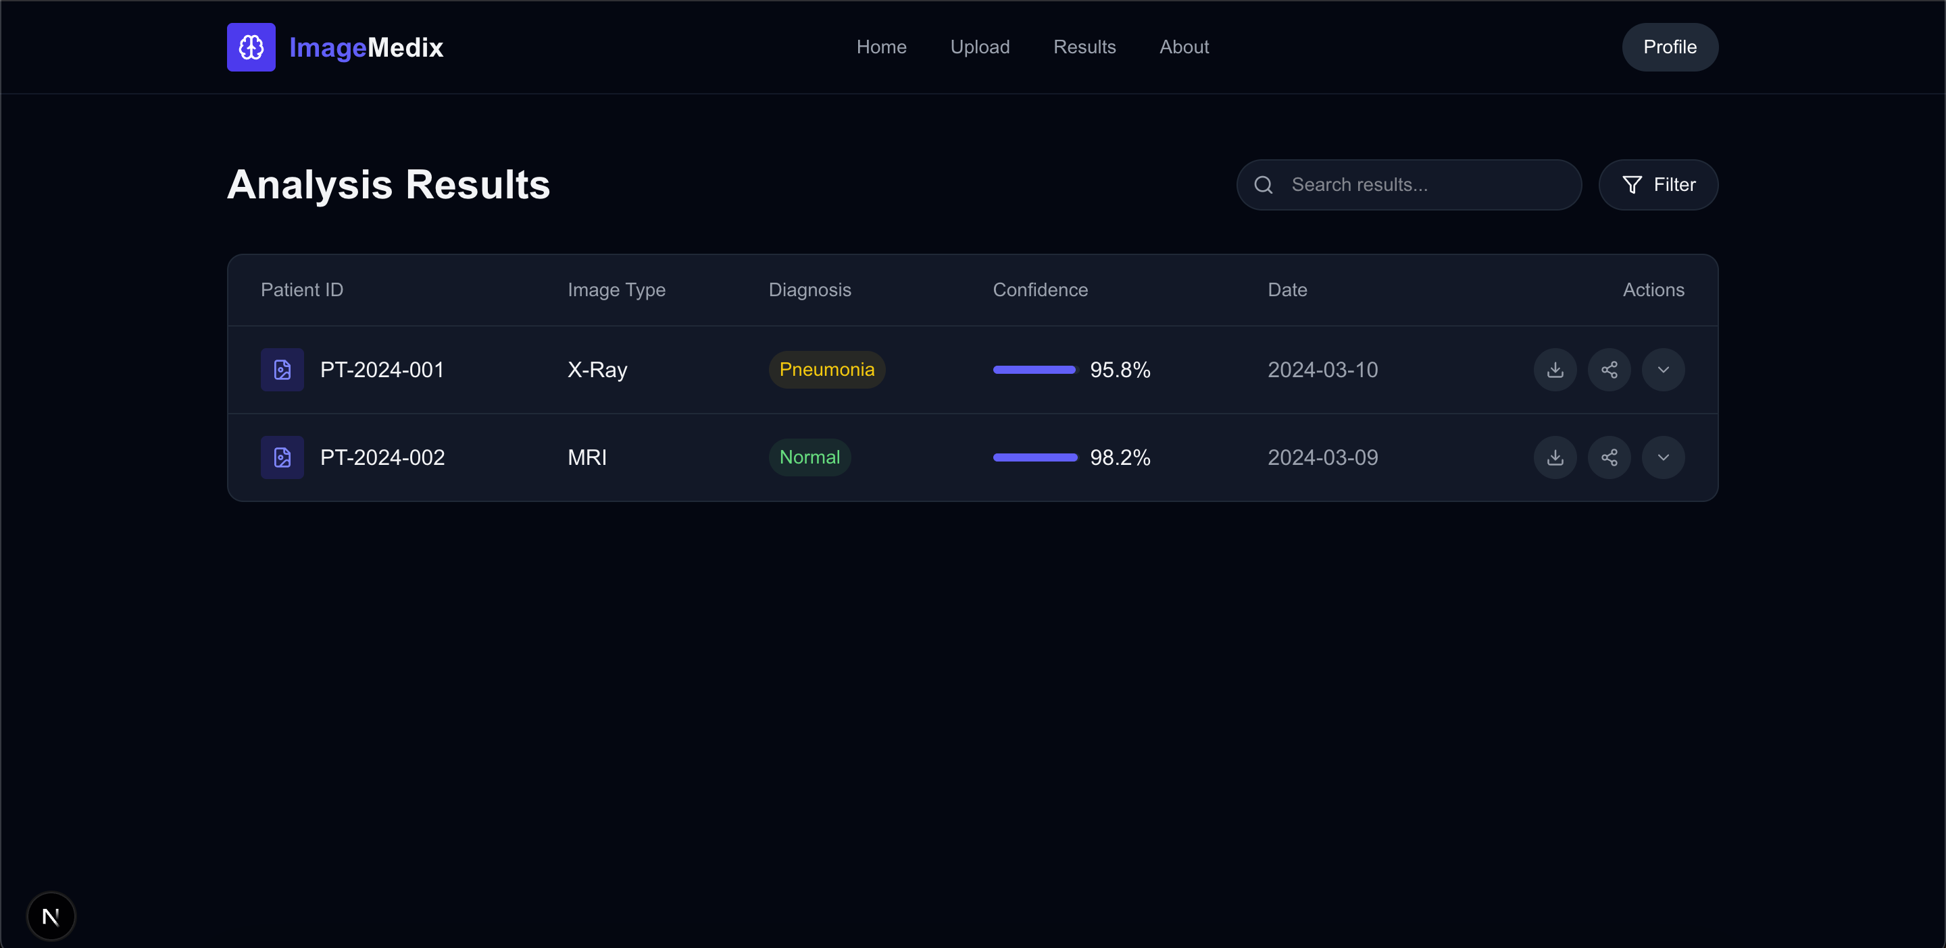

Slide 43
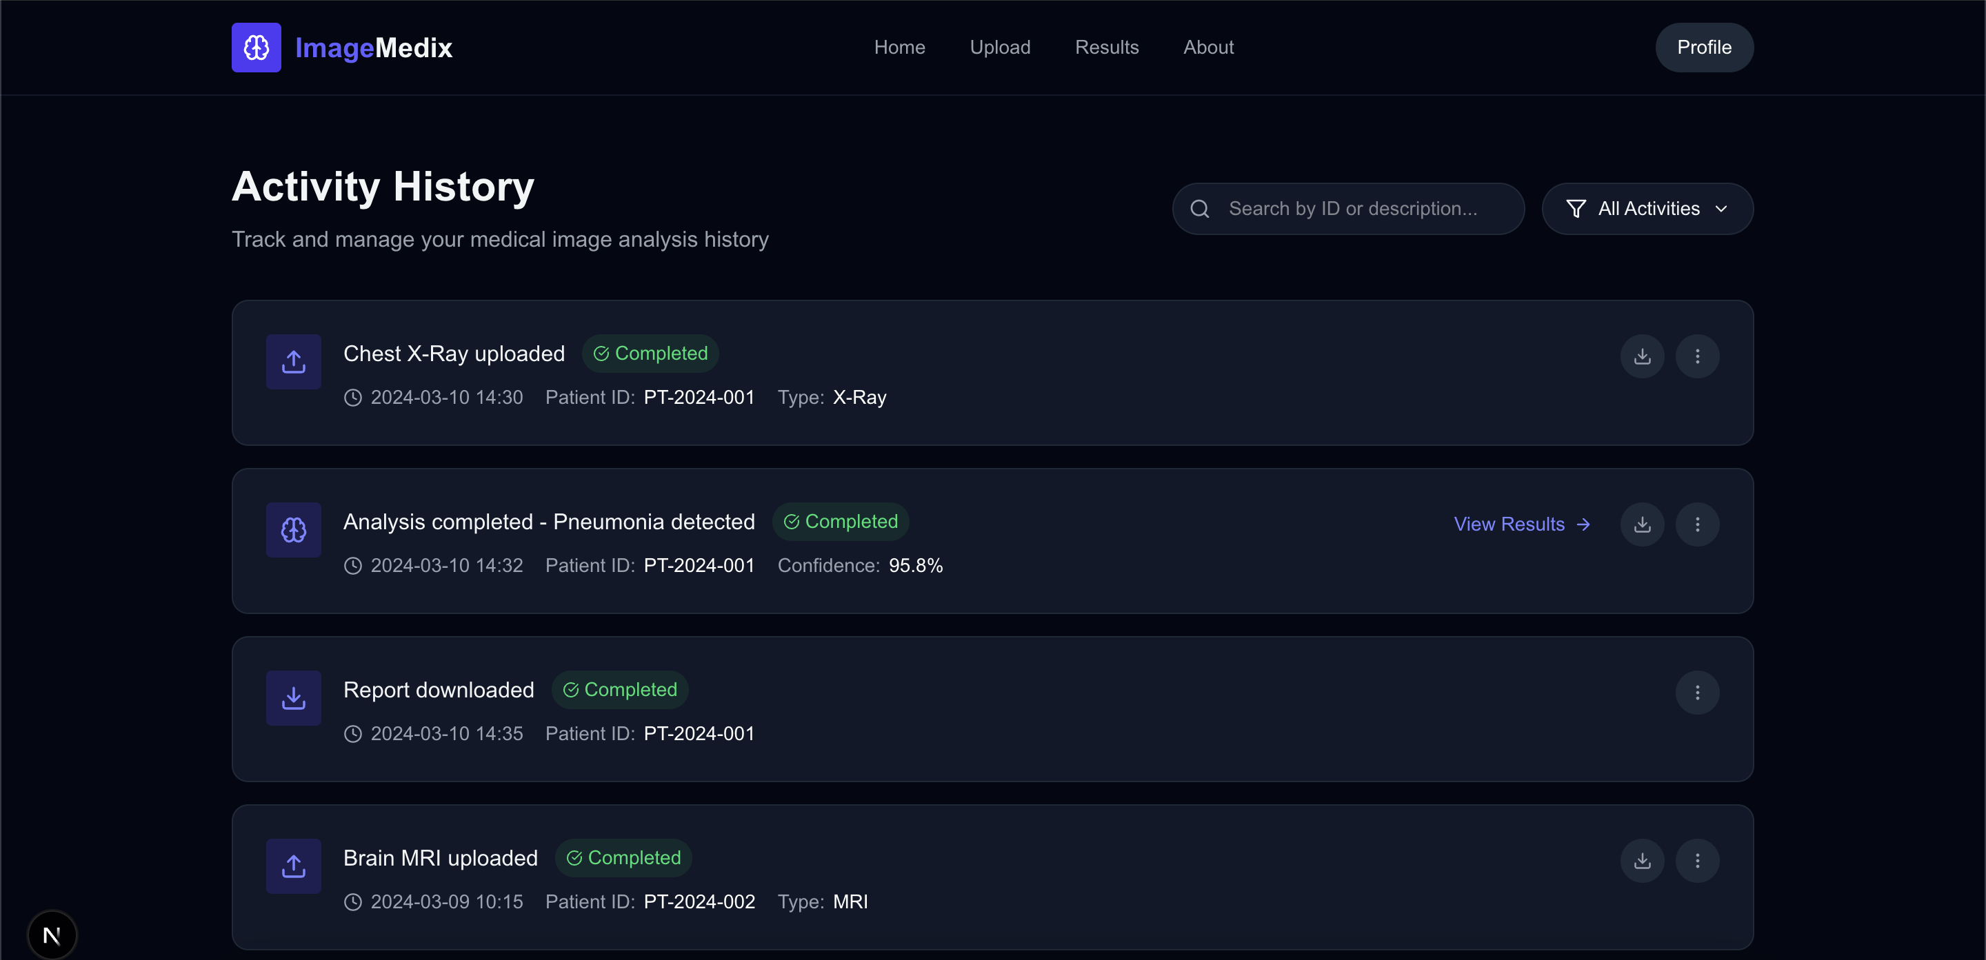

Slide 44
Wikipage linK
https://github.com/htmw/2025S-The-Minions/wiki

Slide 45
Application Demo

Slide 46
tHANK YOU

